Slide 1
Dungeon rush

Slide 2
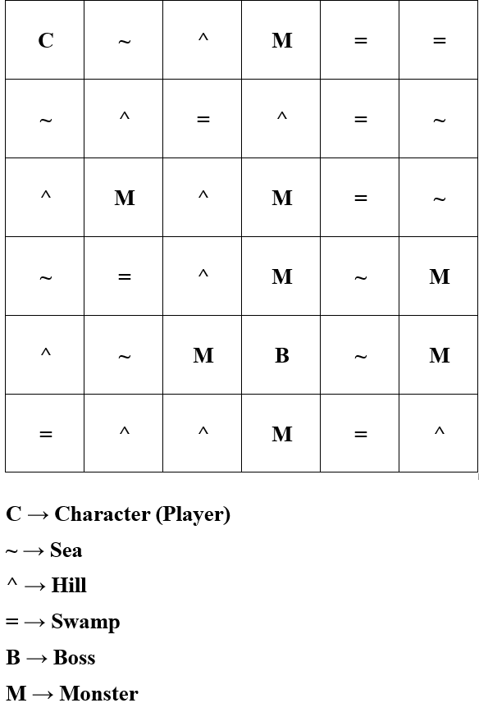
Combat system and map
The map will be generated randomly with a few limitation.
The combat system: turn based combat.
There are story piece found in some places of the map.

Slide 3
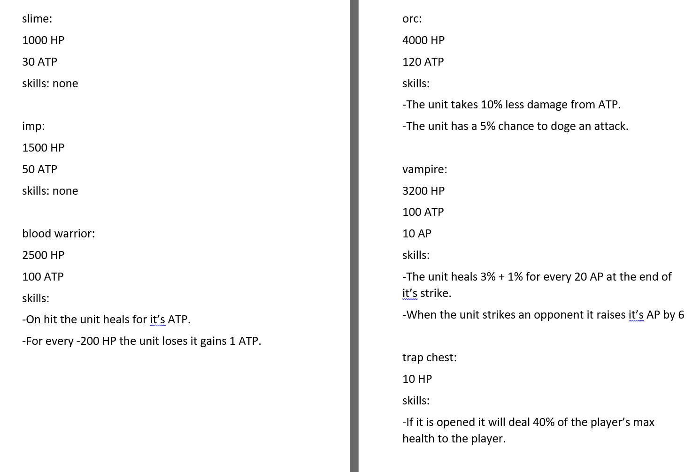
Units
There are different mobs and all of them has different passive abilities or they just do not have one.
The stats are already created but it may change due to balance issues.

Slide 4
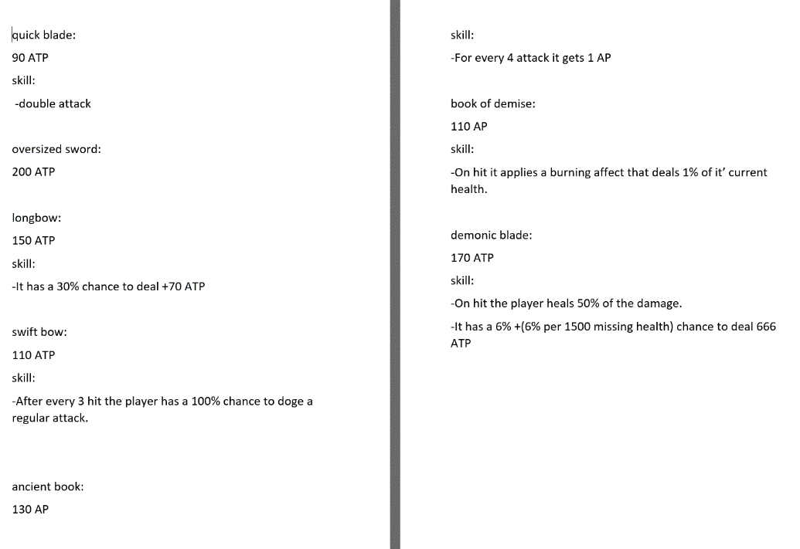
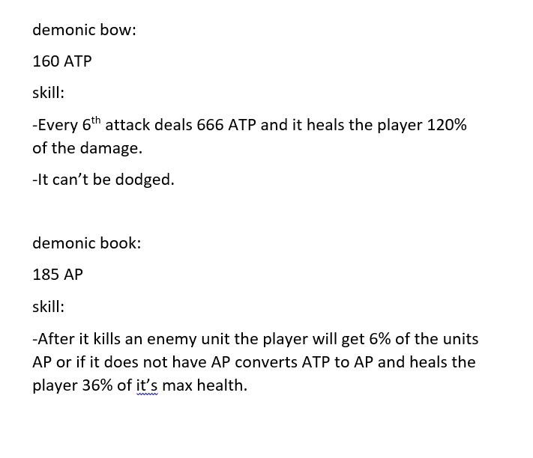
weapons
There are weapons hidden in chests all over the map.
Every weapon has it’s own stat and passive abilities.
Only one weapon can be in the players inventory.
There are drop rates for each weapon and in different locations there can be different drop rates.

Slide 5
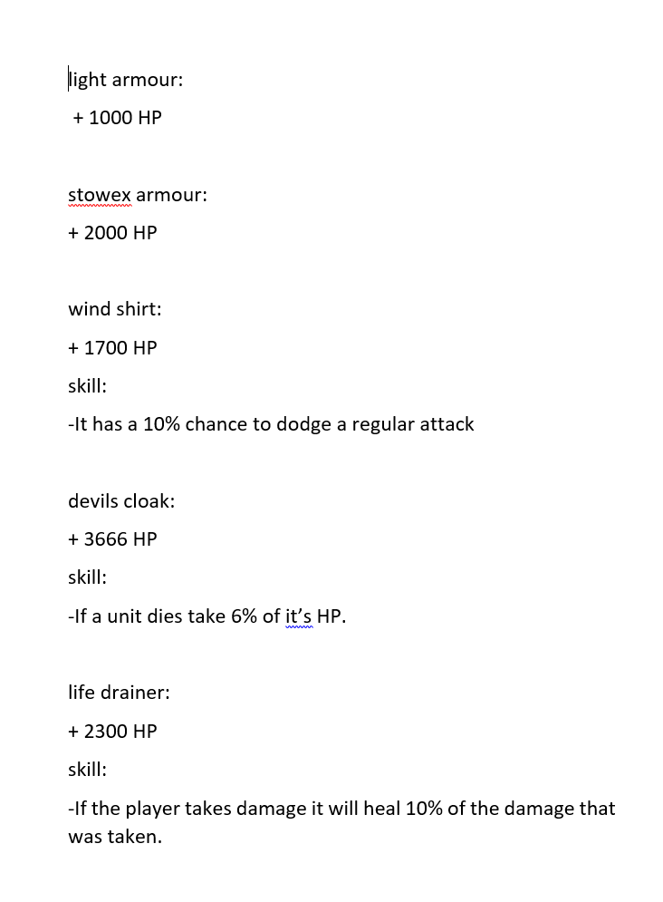
armours
There are armours in chests all over the map.
Every armour has it’s own stat and passive abilities.
Only one armour can be in the players inventory.
There are drop rates for each armour and in different locations there can be different drop rates.

Slide 6
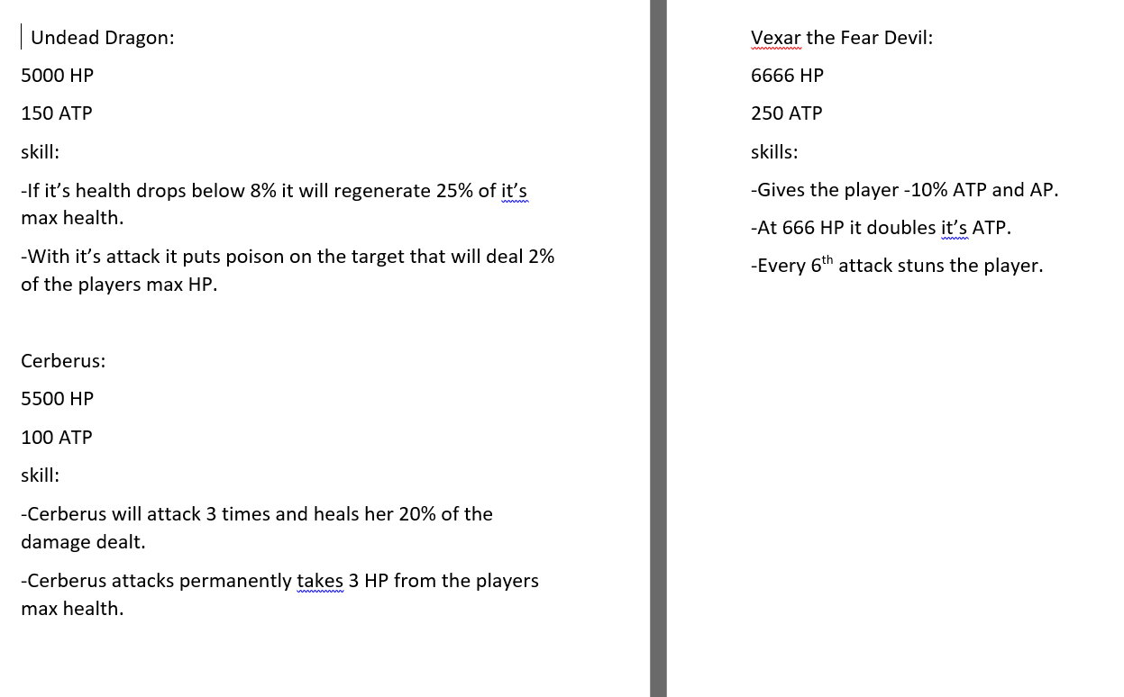
Bosses
There are 2 different bosses and 1 final boss.
These units are very dangerous so be prepared for them.
The player can only defeat the final boss if the other 2 bosses were defeated.
After the final boss was defeated (or not if it was chosen to) then the game ends.

Slide 7
Thank you for your attention!

